Slide 1
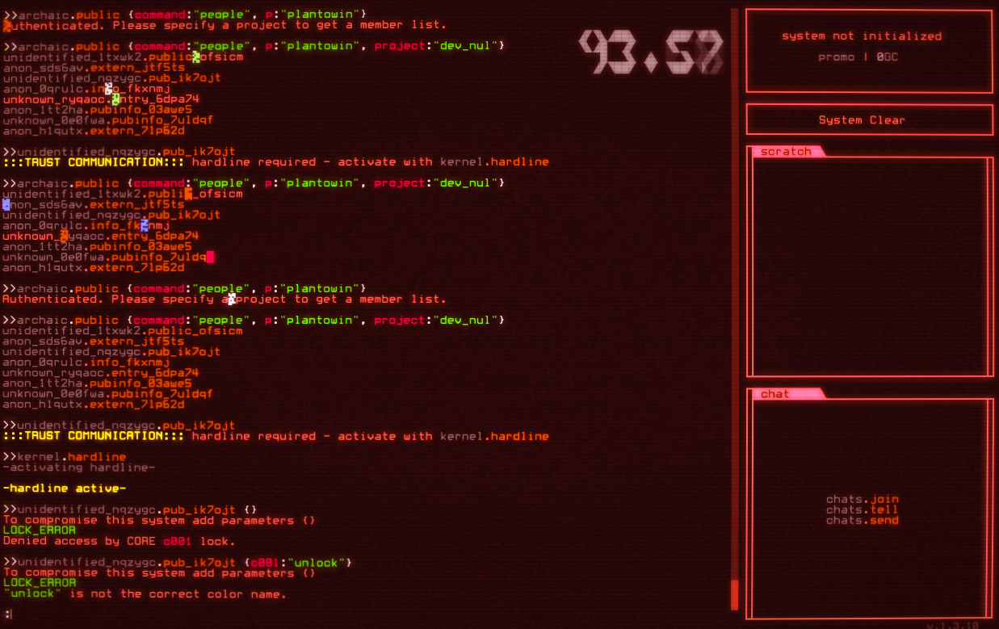

OSINT: Open-Source Intelligence - Go Wild Edition
The thing that happens during an pentest assessment or before a hacker goes ham on a network!
By Stephen Chavez
Notes:
Hey everyone,
I am Stefan. This presentation is my introduction to Open source intelligence. I was invited here to share knowledge with you that I had gotten over the years. I am excited and glad to be here.
The Internet is an ocean of data which is great when you need answers fast. The internet is free and accessible to most people. But, with a lot of data being public. It gets harder to know who has access to your data and devices. As such, we developed ways to find data that you may not realize is public. I will show you some concepts and tools on information gathering so everyone can check for themselves. There will be a live demo at the end of the presentation.

Slide 2
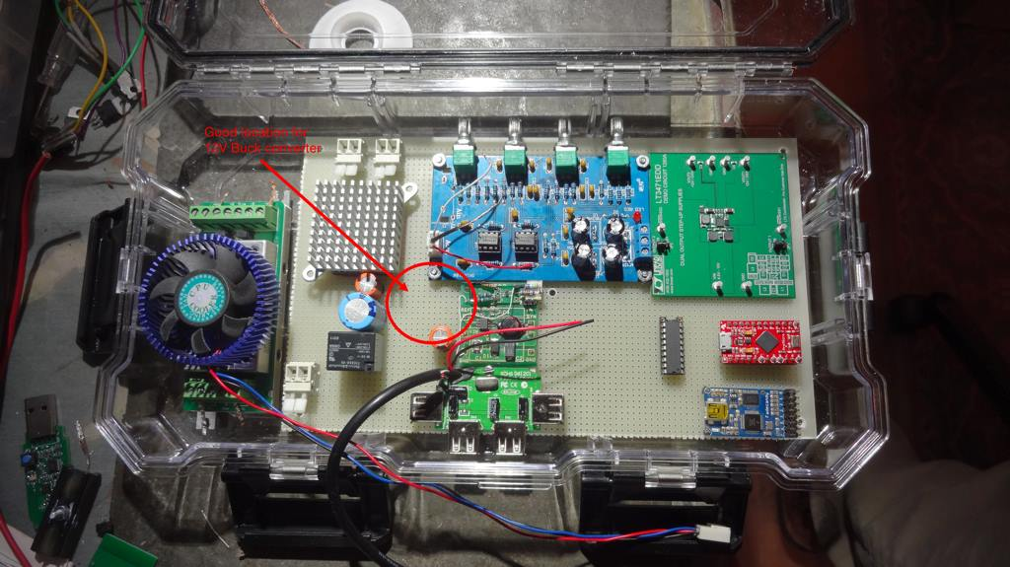
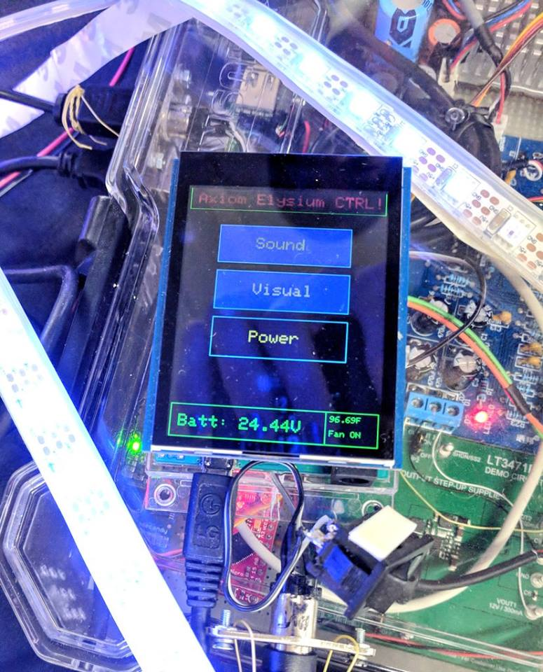
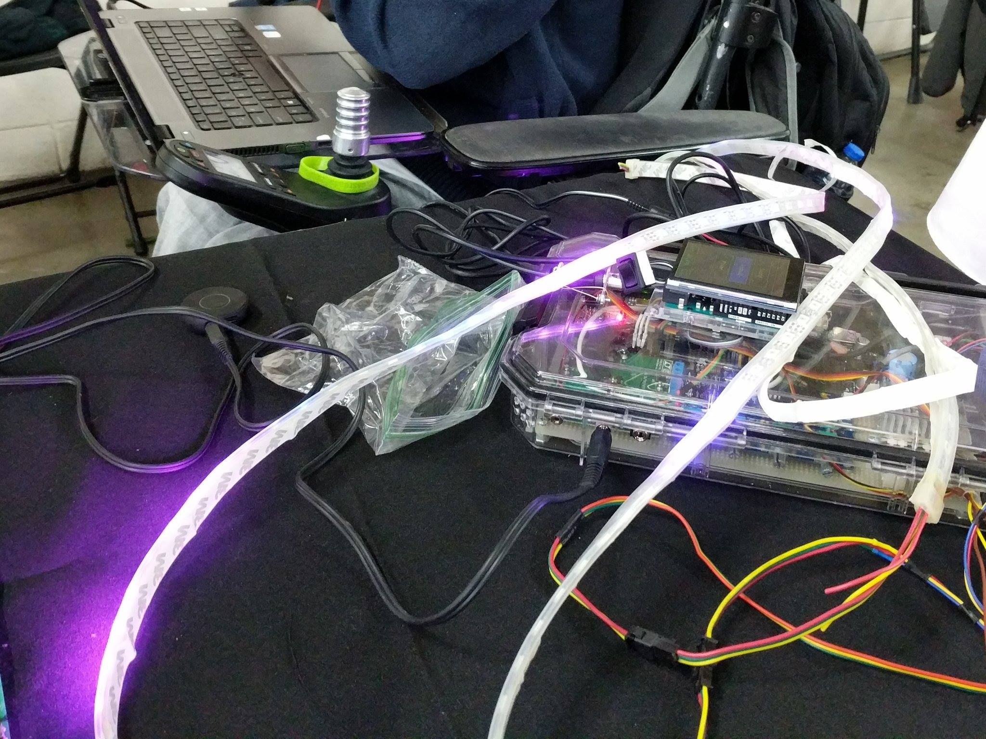
▶ whoami
--------Stephen/Life--------
What is my life story?
Born in Denver, Colorado in 1993
With a rare brain disorder: Schizencephaly - NOT cerebral palsy
Always liked technology
A tinker and hacker
Notes:
So why am I here and who am i? Well.
I have a condition called skizense cephaly. It is an extremely rare brain condition that at the time, not much was known about it. It can affect everything from physical motor skills, logic skills, speech skills, hearing, eyesight, muscle, and spinal cord communication. I had one of the worst cases at the time and I am not supposed to be here right now. I was to be a vegetable for the remainder of my life and I would have multiple seizures a day. But to everybody's amazement, I don't suffer from the standard issues that this condition brings. I only have the poor motor skills. This is confusing to doctors because I am missing a large portion of my brain.
But none of that stopped me. I learned that from an early age.
While growing up. I liked technology. Then learned how to break it afterwards.
As you see from the slide, I work on hardware like arduino and lights. And getting tattoos. I also visit cool places. I was a judge for NASA a while back, judging high-school student projects.

Slide 3


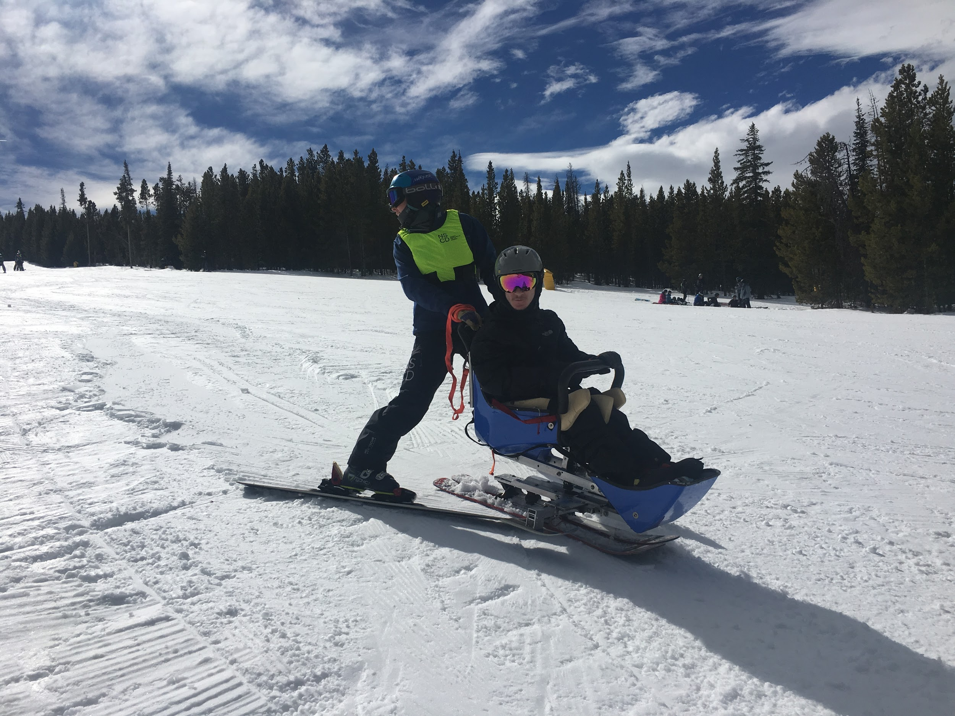
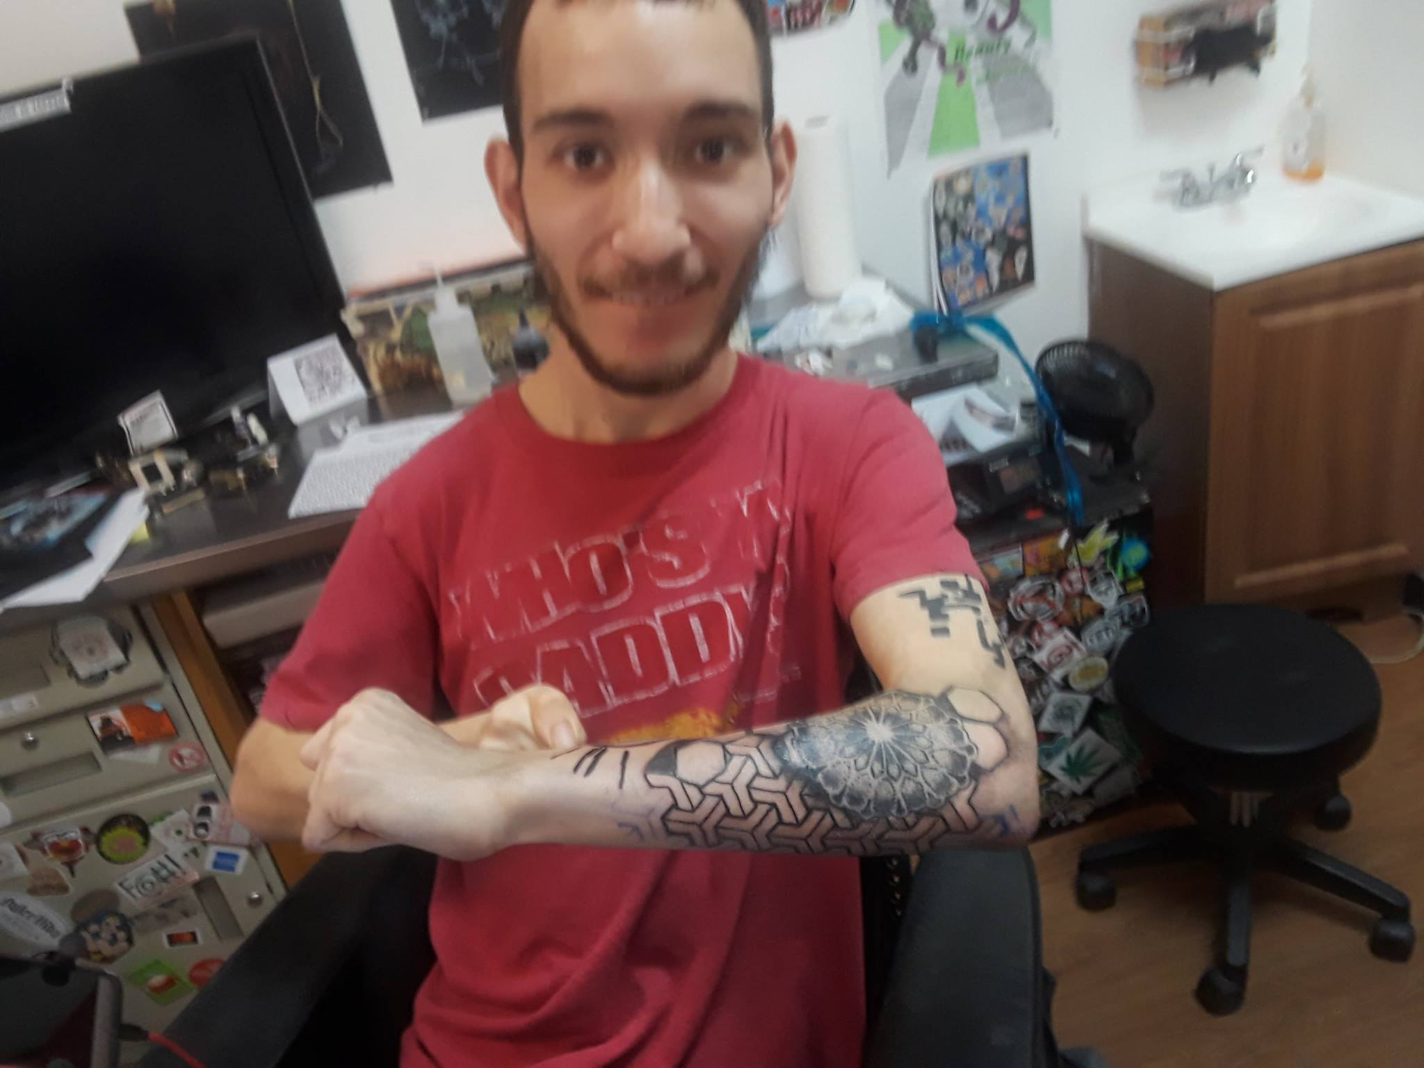
▶ whoami - Continued
--------Stephen/Hobbies--------
What are my hobbies?
Listen to a lot of music - Spotify :)
Digital Art Design
Can’t always think in code
Getting Tattooed
Skydiving
Skiing
Hanging at events
Colorado Blockchain events
Crazy stuff with friends
...

Slide 4
▶ whoami - Continued
--------Stephen/Education --------
~Education~
~Training~
Mobile Web Specialist Nanodegree 2018 - Udacity
Grow with Google Scholarship
Computer Science Major, Math Minor 2016- MSU Denver
Sanity was lost during senior year
Daniels Fund Scholar - 2011
Full ride university scholarship
SecureSet Wargames 2018 - Denver
To continue my path in information security, I chose to do a 3-month course on modern malware analysis, network security, applied cryptography, strategy, and governance, risk management, and compliance
Loco Moco Security Conference 2019 - Hawaii
While attending this conference. I got training. This highly intensive and interactive 2-day course provided essential application security training for web application and webservice developers and architects
It was taught by Jim Manico. He is the founder of Manicode Security where he trains people. He is also the founder of Brakeman Security, Inc. and is a investor/advisor for Signal Sciences and BitDiscovery.
Notes:
My education includes degrees and training over the years.
My newest degree is Mobile Web Specialist by Udacity
It was a 3 month program on web apps. This taught me how to make Accessible and Responsive Web Apps with the latest web tech: Such as Service Workers, Background Sync, etc. – As a result I
was able to show that I had the skills to build real world offline capable webapps that worked with limited resources. I built a performant restaurant review webapp as my final project.
My next degree is my computer science degree. From Metro State University of Denver
For my undergrad capstones, I built two big projects in teams. The first project was a Federal Aviation Administration collision-avoidance system for
the cockpits of all aircraft. The system will receive real-time radar data and need to continuously calculate if a collision is likely, and give several
different levels of warning. The second project was a honeypot server that allows connections to be made to it, and mimics the appropriate
protocols that are defined as addons without actually allowing system access. It gathers information from whoever attempts the connection, and
stores the information remotely in a Mongo database. This application was built around running on a RaspberryPi Zero to make it easy to deploy
in any physical environment with a network. We wanted a cost effective solution that could be installed in a matter of minutes.
For university, I got a full ride scholarship from Daniels fund in 2011.
For my training,
I went to Secureset in denver. They had wargames that taught information security.
It focused on course material on modern malware analysis, network security, applied cryptography, strategy, and governance, risk management, and compliance
And finally, I am going to hawaii in april for more training. At Loco Moco Security Conference. While there. I will be getting trained in a highly intensive and interactive 2-day course provided essential application security training for web application and webservice developers and architects.
t was taught by Jim Manico. He is the founder of Manicode Security where he trains software developers on secure coding and security engineering. He is also the founder of Brakeman Security, Inc. and is a investor/advisor for Signal Sciences and Bit Discovery.

Slide 5
▶ whoami
--------Stephen/Cyber Security Guy--------
Overall work experience:
Worked at: MSU Denver I.T.
MSU Helpdesk Team ~ 2 yrs
MSU Denver Infosec Team ~3 yrs
Current: Software /Infosec Freelancer (Contact me for details)
Since graduation in 2016
To build up experience for my future dream career
Allowed me to take time off for other projects
To keep my sanity after graduation
Notes:
My Overall work experience includes :
two positions at MSU Denver. information technology services, such as the
Helpdesk Team for about 2 yrs and then i switched to the Infosec Team. for about 3 years. That was fun since it was actual work. I got to work with some cool people during my time there. I hope to see them after my talk.
But for current work: I am an freelancer working on small projects.
Since graduation in 2016.
To build up experience for my future dream career. As a redteam member or attack tool software engineer. Which creates special tools and exploits for redteams.

Slide 6



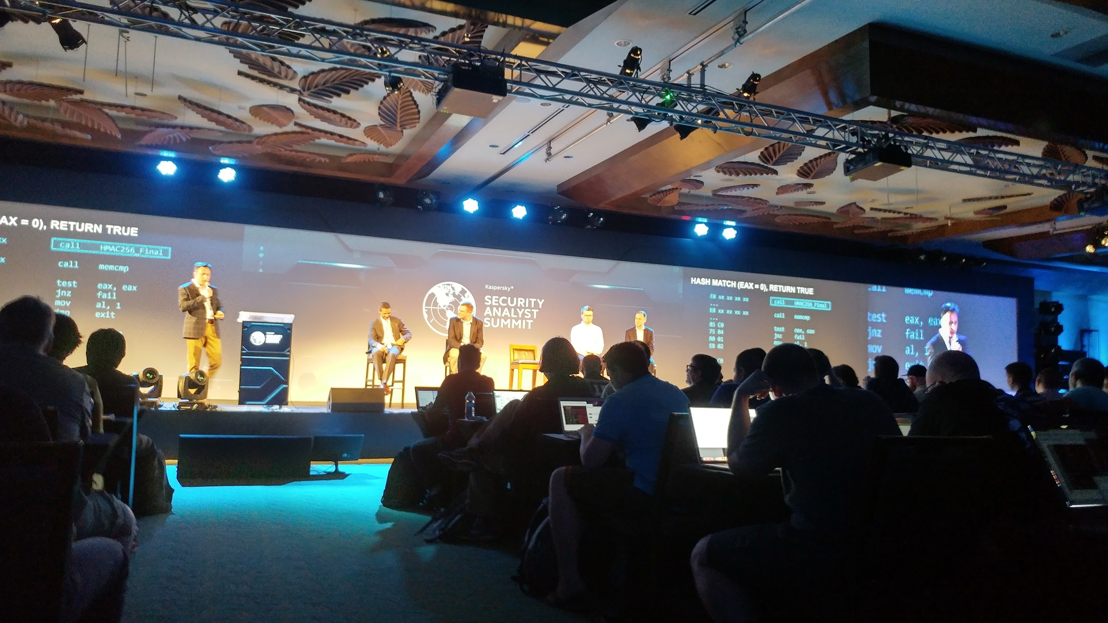
▶ whoami
--------Stephen/Conferences--------
I am a public speaker at various events:
DEFCON 24
GeekPWN 2016
Kaspersky SAS 2017
SecureSet expert panel series
Attending awesome events like:
BlackHat 2016
ETHDenver 2019
LocoMocoSec 2019
Notes:
For the conference life,
I attend and speak at awesome conferences all over the world. They are:
DEF CON 24.
Geek Pawn 2016.
Kaspersky Security summit 2017.
SecureSet expert panel series.
BlackHat 2016.
ETHDenver 2019. And finally,
LocoMocoSec 2019.

Slide 7

▶ Hacking power-wheelchairs
Demo:
Notes:
The word is that,
I reverse engineered a medical protocol called R-Net.
R-Net is an extension to canbus. R-net is meant to be a multi-module electronic system designed specifically to control the speed, direction and many other functions on powered wheelchairs. This is the intended purpose and function. And to set the bar on it’s competition, R-Net tries to be future-ready too.
It allows for “on the fly” device configuration, as well as adding new devices to chairs. But the options for users are limited. Users only have a few addonsto make their lives more easy, the only exciting addons are the light module (which adds street hazard lights), and the bluetooth module.
It appears that innovation in this area has stopped completely until I came along with my research. The addons that do exist are completely outdated and strangely limiting, lowering its overall usefulness to the user. These devices do not fit in the 21 century.
I will now play a demo video.

Slide 8
▶ Hacking power-wheelchairs...and wardriving?
Why hack the chair?
Can’t talk while typing
More customizable
Personalize your chair
With sensors
LED lights
Speakers and ETC…
But WAIT, we can do other things with the wheelchair to our advantage! Combining my passions with style.
Wardriving and OSINT
Hacking
Notes:
Pretty cool demo, right? So Why hack the chair?
Well, I Can’t talk while typing to people. And.
That's a problem. I want to fix that.
As the hacking allows
More customizable options like sensors and it will let you to
Personalize your chair
With sensors.
LED lights.
Speakers and ETC.
But WAIT, we can do other things with the wheelchair to our advantage! Combining my passions with style.
wardriving and Open source intelligence. And
with a bit of Hacking.
These things allow for crazy things. For example, imagine that I need to do a pentest or recon mission on some company or person. I could easy use my research to add passive wifi scanning hardware or anything else. People will think i need it if they see me in my chair.
I'm sneaky like that!
I'm in a wheelchair and you see my laptop with all of my gadgets. I need
it to talk with anyone. People think I'm super harmless and all like
Steven Hawking. You are not seeing a hacker, oh no of course not!
Why would you? Since everyone assumes that I'm not able to work like other people in wheelchairs.
Well, let me say 1 thing. They are totally screwed to think that.
I'm using my social engineering skills to the next
level and my chair hardware in an unique way. What if I told you that my
physical limitations are in fact, an attack vector? How is this possible? Well, Let
me show you tools that make this possible in the next few slides.

Slide 9
▶ Hacking power-wheelchairs...and wardriving?
What is wardriving?
Wardriving is the act of searching for Wi-Fi wireless networks and devices by a person usually in a moving vehicle, using a laptop or smartphone. Software for wardriving is freely available on the Internet.
The data can be used to find free wifi AP spots from afar (2 miles)
Data can also be used to map locations
Examples on the next slides!
Notes:
You may be wondering what is wardriving?
Wardriving is the act of searching for Wi-Fi wireless networks and devices by a person usually in a moving vehicle, using a laptop or smartphone. Software for wardriving is freely available on the Internet.
The data can be used to find free wi-fi AP spots from afar. Range can be up to (2 miles) with the correct hardware.
Data can also be used to map locations. And a lot more.
Examples on the next slides!

Slide 10
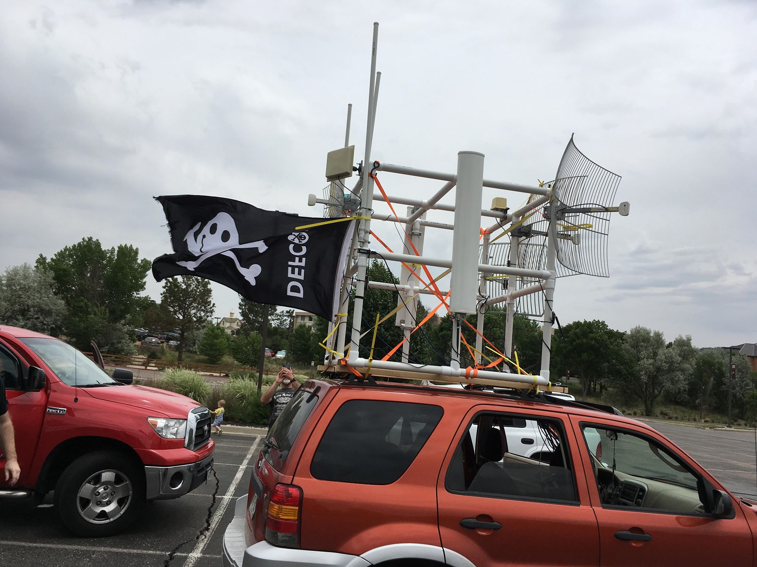
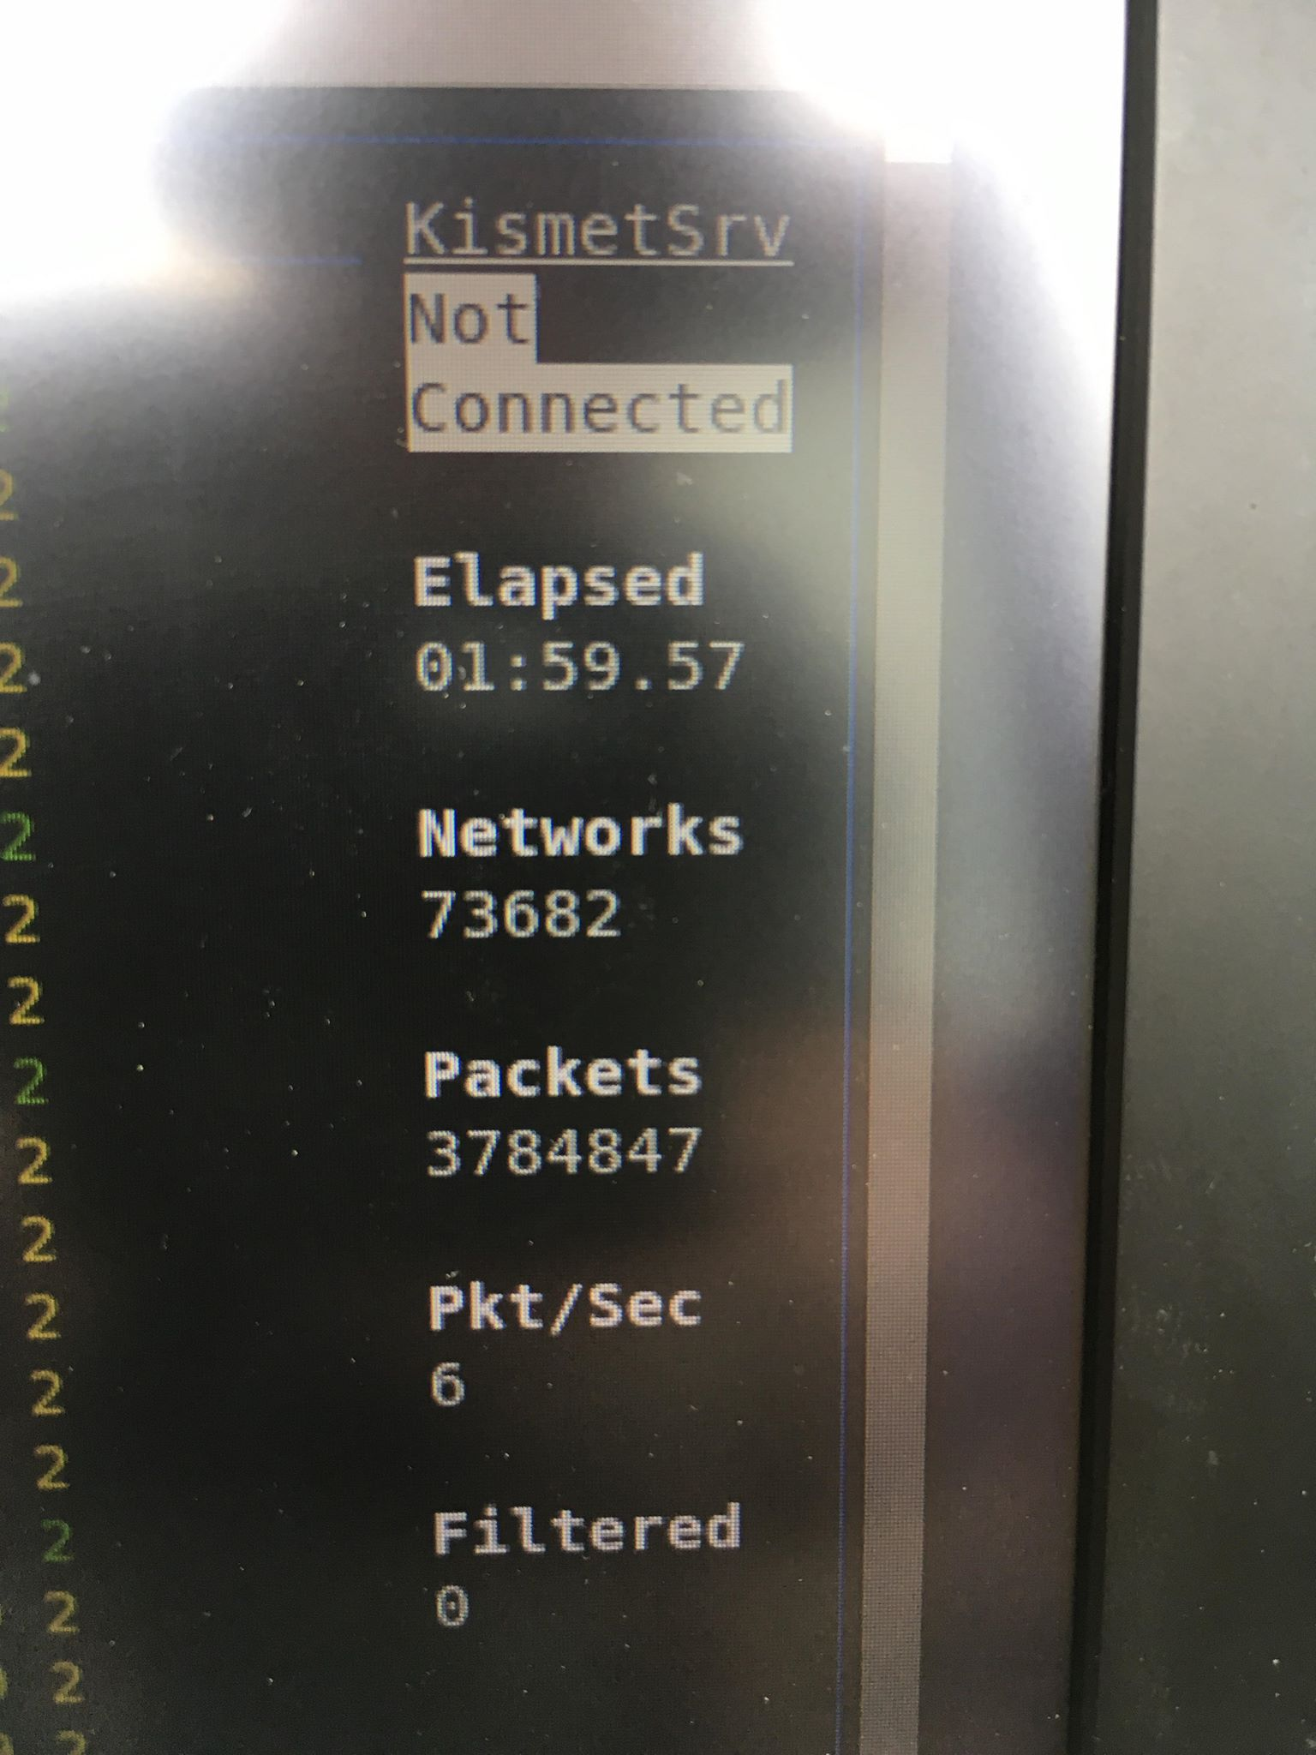
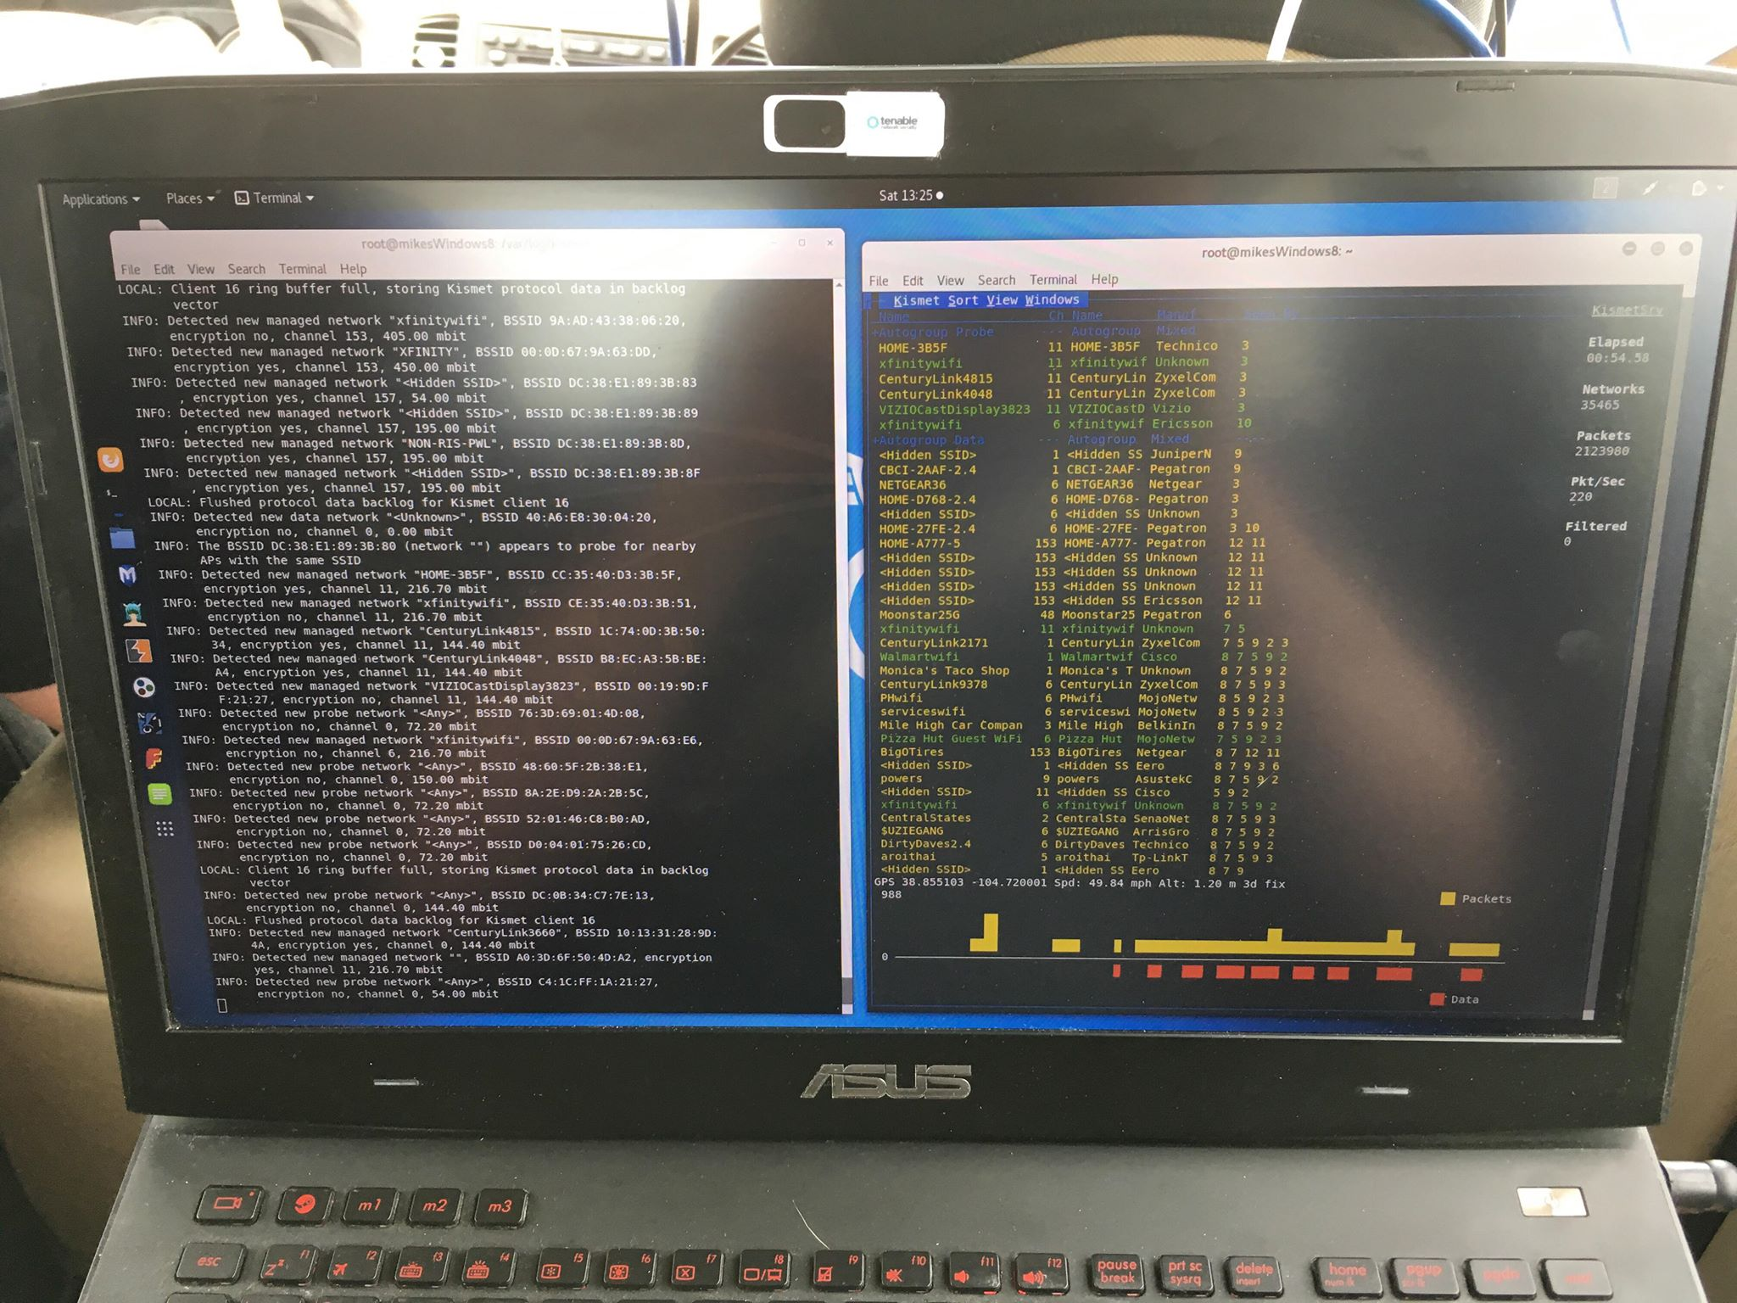
▶ Hacking power-wheelchairs...and wardriving?
Friend’s setup when wardriving!
Notes:
In this slide you will see a really, really big WI-FI antenna. With a DEF CON flag, because you might as well go out with a bang.
You can imagine that people and the goverment are wondering what the hell you are doing. And you'll be right. Like hackers, they also have cool hardware to detect stuff like this.
This is a friend's setup that they drove for 2 hours. In this time period, they found about 74,000 networks. They were able to do this, because they were not actively searching or exploiting networks. In some cases, wardriving is legal if you are just passively listening. And my friends did just that. So when they were questioned by the secret service agents or FBI agents that watched them, they were fine to go scott free.
And before you go do this, do your research and read up on the regulations and laws. Otherwise you will be in hot water.

Slide 11
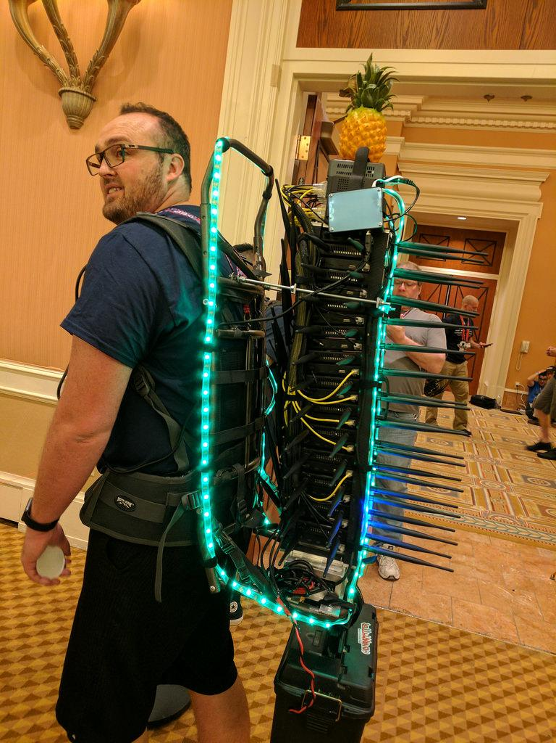
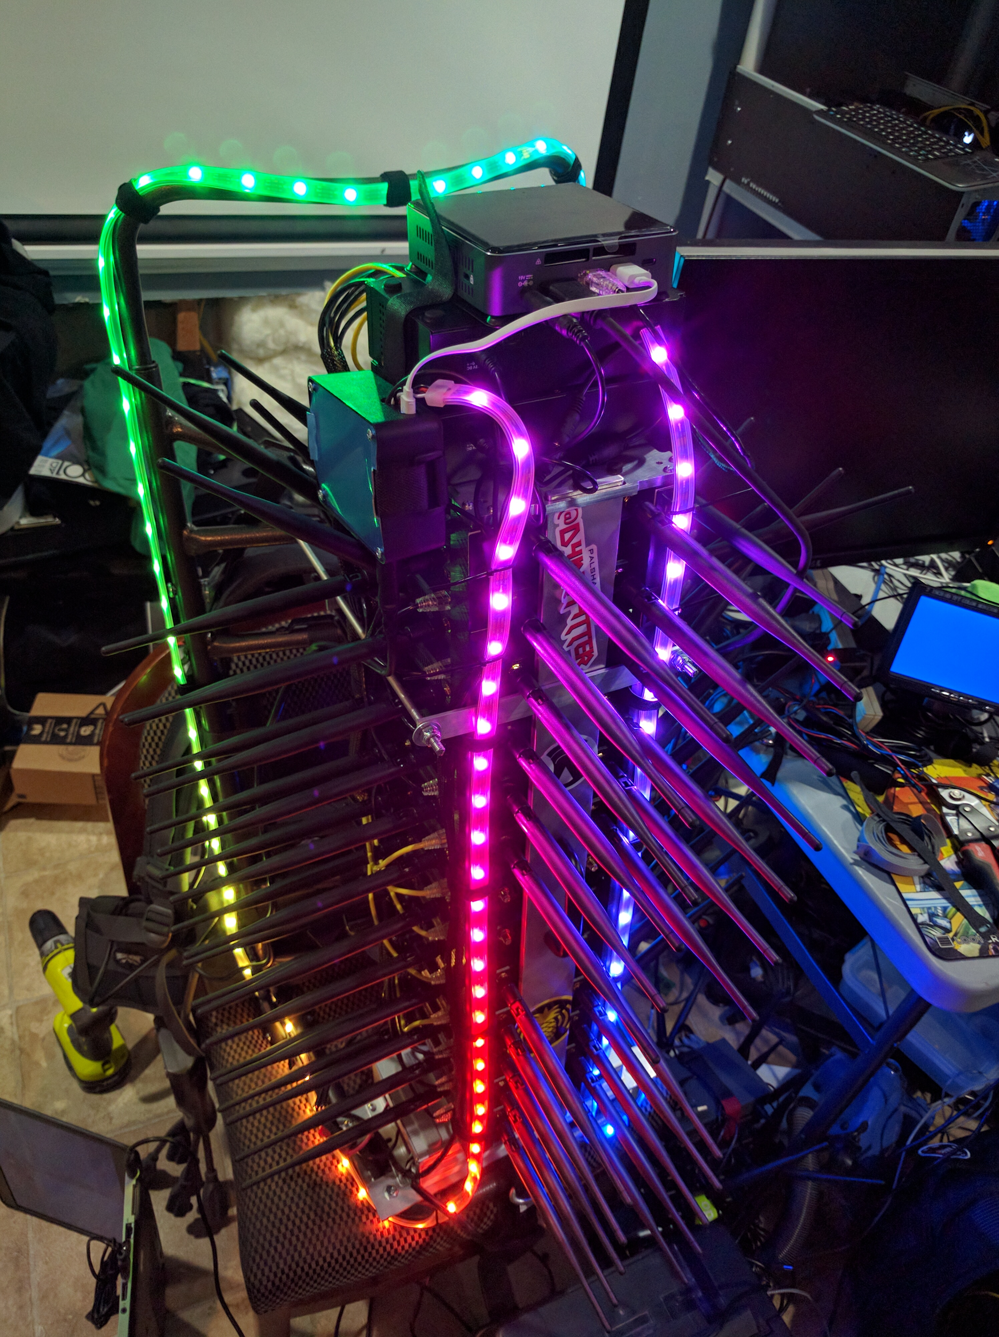
Walking Wardriving
HMM...
PERFECT WAY to gather info!
What’s the evolution of Walking Wardriving?
Notes:
Wardriving isn't limited to just cars. You can go small scale, on foot.
This is called the WI-FI cactus.
By now, you probably know where I'm taking this.
IF NOT, see the next slide.

Slide 12
Power-wheelchair Wardriving
HMM...
Oh yuss, geniuszz!!! Power-wheelchair wardriving!

Slide 13
▶ Open-Source Intelligence
What is OSINT?
OSINT stands for Open-Source Intelligence, and it is one of the key aspects in understanding the cybersecurity that rules the Internet and devices these days. Or any other aspects in activities that need information gathering
You probably want to know what exists on a network at some point
The kind of things you can find can be very interesting (...about anything)
But how?
Notes taken from https://securitytrails.com/blog/what-is-osint-how-can-i-make-use-of-it
Notes:
Even though i have my power-wheelchair to gather data. The data is useless. We need tools to help us understand what we collected. That is Open-Source Intelligence, and it is one of the key aspects in understanding the cybersecurity that rules the Internet and devices these days. Or any other aspects in activities that need information gathering.
For example, You probably want to know what exists on a network at some point.
The kind of things you can find can be very interesting, you could find images of yourself on a random spot. Or fake profiles of your dogs. Anything is possible and will be done.
But the question is what tools you use?

Slide 14
▶ Open-Source Intelligence - Continued
What is OSINT?
Open source intelligence (OSINT) is described as information collected from public sources such as those available on the Internet, although the term isn't strictly limited to the internet, but rather means all publicly available sources.
"OS" (from OSINT) means Open Source. In this case, it is not related to the famous open source software movement, but to any publicly available source where the user can obtain the information in their intelligence data collection.
Twitter posts
Facebook posts
Blogs
Newspaper
DNS Records
Notes taken from https://securitytrails.com/blog/what-is-osint-how-can-i-make-use-of-it
Notes:
Open source intelligence (OSINT) is described as information collected from public sources such as those available on the Internet, although the term isn't strictly limited to the internet, but rather means all publicly available sources.
And the words open source mean something else in the intelligence world. In this case, it is not related to the famous open source software movement, but to any publicly available source where the user can obtain the information in their intelligence data collection.
Sources like:
Twitter posts.
Facebook posts.
Blogs.
Newspaper. OR
Domain name service Records. So Basically You can use any public source you want.

Slide 15
▶ Open-Source Intelligence - Continued
The key concept of OSINT:
The core concept to grasp is the information gathering, and most importantly, any information that can be obtained for free is open source. It doesn't matter if it is located inside newspapers, blogs, web pages, tweets, social media cards, images, podcasts, or videos as long as it is public, free and legal to use*
*Things that can't be called open source include: private information, best friend secrets, or stuff that is not public to others.
Of course, you can apply the same gathering techniques to private information or any system. We are just using information that is out there already.
Notes taken from https://securitytrails.com/blog/what-is-osint-how-can-i-make-use-of-it
Notes:
Here are some key points to follow:
information gathering is the important thing in open source intelligence.and most importantly, any information that can be obtained for free is open source. It doesn't matter if it is located inside newspapers, blogs, web pages, tweets, social media cards, images, podcasts, or videos as long as it is public, free and legal to use.
*things that can't be called open source include: private information, best friend secrets, or stuff that is not public to others.
Of course, you can apply the same techniques to private information or any system. We are just using information that is out there already .

Slide 16
▶ Open-Source Intelligence - Continued
Everyone uses OSINT…
Many of us might associate OSINT to cyber war, cyber attacks, cybersecurity, etc. And while those things are a part of it, OSINT is much more explicit and uncomplicated
Everyday OSINT examples include:
Asking questions on any search engine.
Research public forums on how to fix your computer.
Watch a youtube video on how to make a birthday cake.
Looking on Facebook for your girlfriend’s Birthday date… Don’t lie, you probably did this!
As you see, you don't need to be a hacker to use OSINT in your daily life: you're already using it, you just might have not known it!
Notes taken from https://securitytrails.com/blog/what-is-osint-how-can-i-make-use-of-it
Notes:
fun fact, everyone uses Open source intelligence.
Many of us might associate Open source intelligence with cyber warfare, cyber attacks, cybersecurity, etc. And while those things are a part of it, Open source intelligence is much more explicit and uncomplicated. Let me explain.
Everyday Open source intelligence examples include:
Asking questions on any search engine.
Research public forums on how to fix your computer.
Watch a youtube video on how to make a birthday cake. Or
Looking on Facebook for your girlfriend’s Birthday date.
So,
As you see, you don't need to be a hacker to use Open source intelligence in your daily life: you're already using it, you just might have not known it!

Slide 17
▶ OSINT Tools
Alright...Time to talk about OSINT tools! Since we are focused on modern OSINT for the cybersecurity fields, we will now take a look at how we can benefit from it.
We don’t want to gather info by hand, especially if it’s an large organization
Tools include:
Maltego - Advanced tool to organize any type of data
Trape - People tracker
Kismet - Kismet is a wireless network and device detector, sniffer, and wardriving tool
...and many more tools exist
Everything listed here is also free to use.
Notes taken from https://securitytrails.com/blog/what-is-osint-how-can-i-make-use-of-it
Notes:
Alright...Time to talk about open source intelligence tools now! Since we are focused on modern open source intelligence for the cybersecurity fields, we will now take a look at how we can benefit from it.
We don’t want to gather info by hand, especially if it’s an large organization. That's too much for our poor hands.
open source intelligence Tools include:
Maltego - this is an Advanced tool to organize any type of data.
Trape - People tracker.
Kismet - Kismet is a wireless network and device detector, sniffer, and wardriving tool.
...and many more tools exist.
Everything listed here is also free to use.

Slide 18
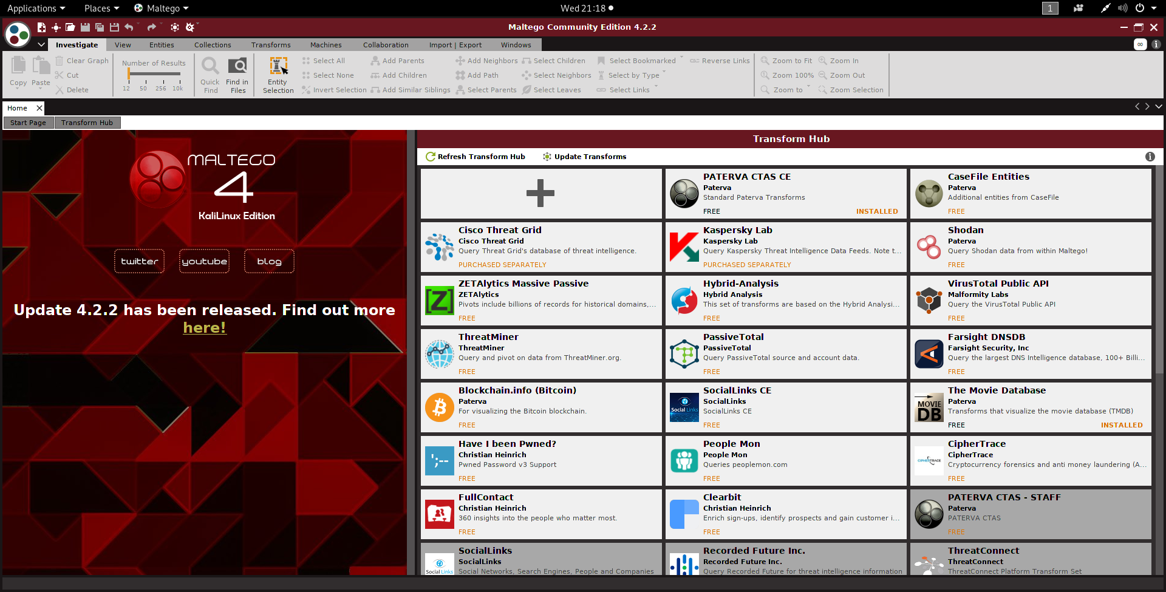
▶ OSINT Tools - Maltego
Maltego CE - Kali Linux edition
Notes:
Finally,
I will now demo maltego on a real world target. And That will be Dr. Steve Beaty. He has given me full permission to do this.

Slide 19

▶ OSINT Tools - Maltego
Example 1: Using Maltego to collect and store info:
…We need a juicy target first. I chose to target Steve Beaty for a few reasons.
(Gained permission from him)
MSU Denver C.S. professor
He is on the news everywhere
He’s also nutty at times (Who knew?)
He has a blog (let’s find it!)
He’s pretty cool and teaches infosec
Thanks again Dr. Beaty!
Notes:
Example 1: Using Maltego to collect and store info:
…We need a juicy target first. I chose to target Steve Beaty for a few reasons.
He is an MSU Denver. C.S. professor.
He is on the news everywhere.
He’s also nutty at times. (Who knew?)
He has a website. (let’s find it!). Plus
He’s pretty cool and teaches info sec.
Thanks again, Dr. Beaty!
Let's open Maltego now.

Slide 20
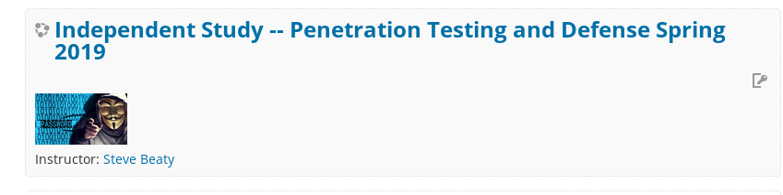
▶ OSINT Tools - Demo
DEMO TIME!
Also, take this class for advanced stuff we didn’t have time for. You won’t regret it.
Notes:
https://securitytrails.com/blog/what-is-osint-how-can-i-make-use-of-it

Slide 21
▶ Contact Info
Email addr: Stephen@dicesoft.net
Twitter: @redragonx
Linkedin: https://www.linkedin.com/in/hacker-stephen/
Thanks for coming!
Notes:
https://securitytrails.com/blog/what-is-osint-how-can-i-make-use-of-it

Slide 22
▶ Resources
Maltego training video for absolute beginners
https://youtu.be/sP-Pl_SRQVo
Simple Maltego tutorial
http://nest.unm.edu/files/7113/8379/8002/maltego.pdf
DEF CON 25 Recon Village - Abhijeth Dugginapeddi - Recon and Bug Bounties What A Great Love Story
https://youtu.be/vCBAQKLAagA
Practical recon techniques for bug hunters & pentesters
https://github.com/appsecco/practical-recon-levelup0x02
Trape: People tracker on the Internet: Learn to track the world, to avoid being traced
https://github.com/jofpin/trape
Notes:
https://securitytrails.com/blog/what-is-osint-how-can-i-make-use-of-it

